Slide 1
Map Types
By: Flavio Rayo

Slide 2
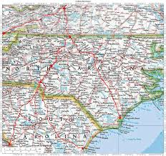
Road Map
Show roadways and physical boundaries

Slide 3
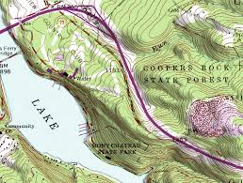
Topographic Map
Have contour lines that show elevation.

Slide 4
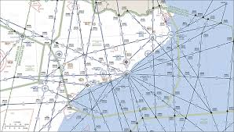
Aeronautical Map
Have information about flight paths.

Slide 5
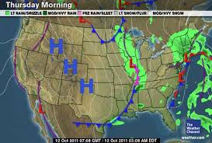
Weather Map
Show locations of weather patterns.

Slide 6
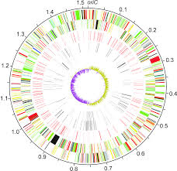
Gene Map
Shows locations of specific genes in DNA

Slide 7
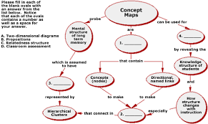
Concept Map
There are several kinds of concept maps.

Slide 8
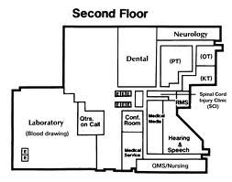
Floor Map
Shows rooms in a building.

