Slide 1
Tech advancements
By: Flavio rayo

Slide 2
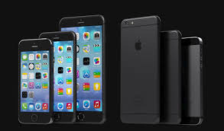
The smartphone
Many types of technology have changed the way we live our daily lives
Smartphone is one of the biggest impact of them all

Slide 3
How it works
this device is mostly used for communication and connecting with others
Communication by calling or texting and picture sending

Slide 4
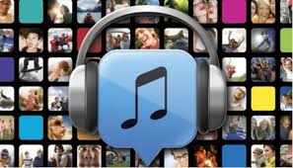
Other features
Not only can you talk to one others on your smartphones, but you can also text, play music or a game, get directions, take pictures, check e-mail, find a great restaurant, surf the Internet and watch a movie!

Slide 5
Job involvement
A smart phone is extremely useful in every job
There are many useful apps you can find in the app store

Slide 6
Steve jobs

Slide 7
resources
www.google.com
www.youtube.com

